Slide 1
Term project dsc530 veronica warren November 18, 2020

Slide 2
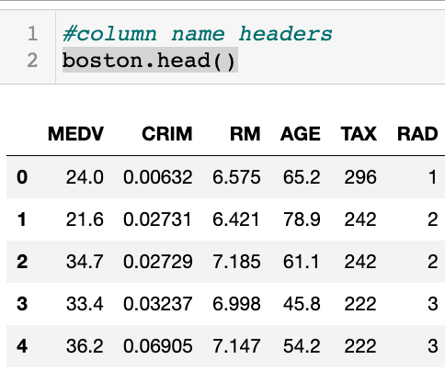
The 5 variables : meDv - median value of owner-occupied homes in $1000's Crim - per capita crime rate by town rm - average number of rooms per dwelling age - proportion of owner-occupied units built prior to 1940 tax - full-value property-tax rate per $10,000 rad - index of accessibility to radial highways

Slide 3
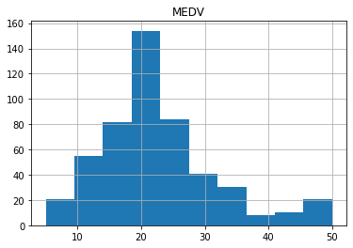
Medv histogram

Slide 4
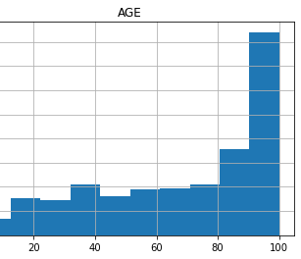
Age histogram

Slide 5
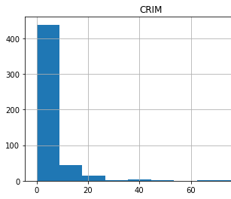
Crim histogram
Notes:
Crim histogram

Slide 6
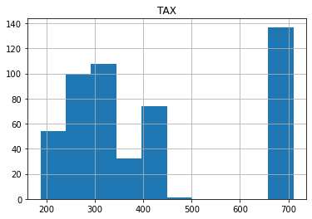
TAX HISTOGRAM

Slide 7
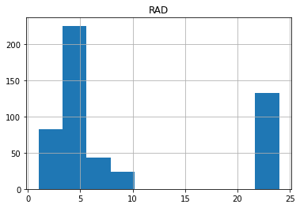
RAD HISTOGRAM

Slide 8
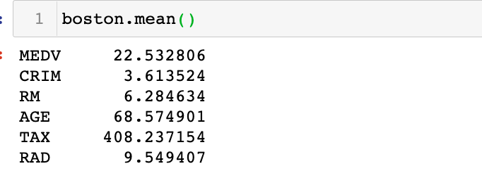
MEAN OF VARIABLES

Slide 9
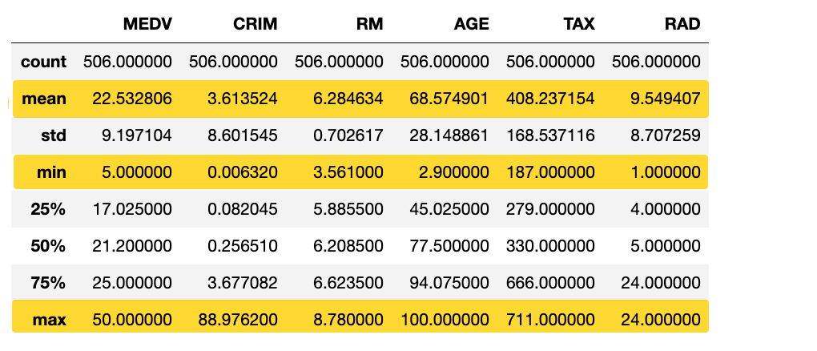
MEAN & TAILS OF VARIABLES

Slide 10
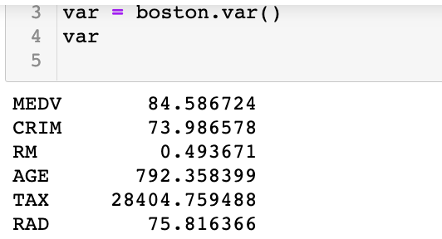
spread

Slide 11
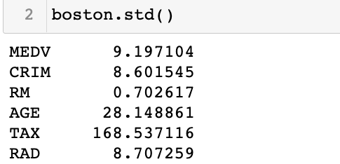
Standard deviation

Slide 12
RM PMF

Slide 13
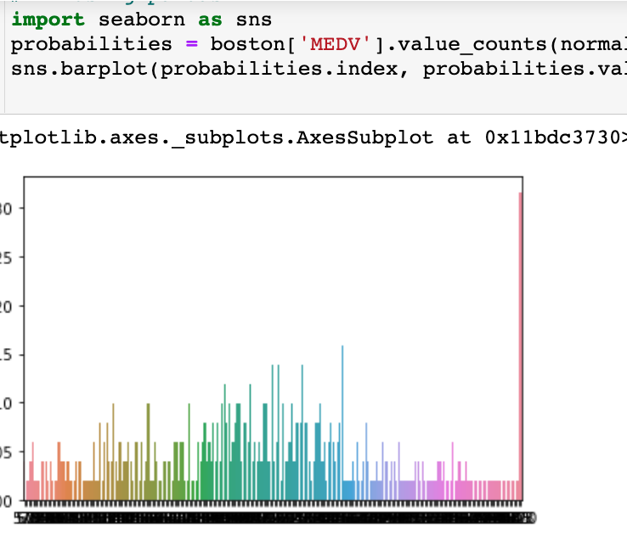
MEDV PMF

Slide 14
Cumulative distribution function (cdf)

Slide 15
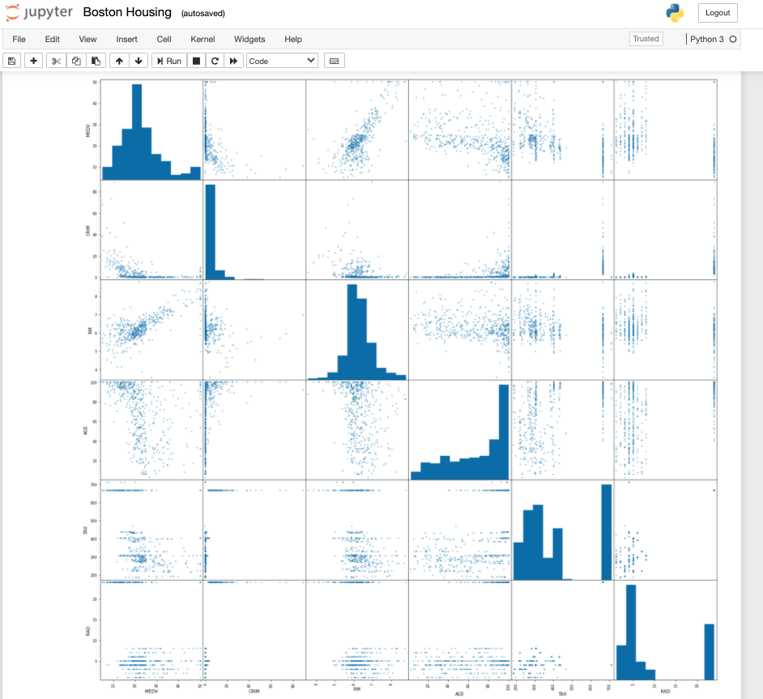
Scatter matrix

Slide 16
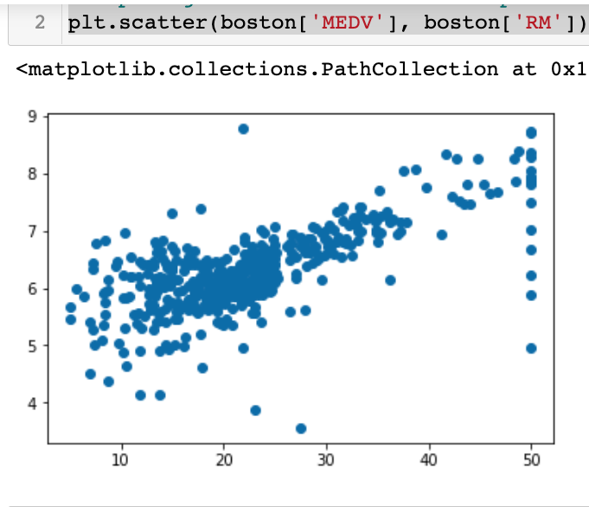
Scatter plot 1 comparing MEDV & RM variables

Slide 17
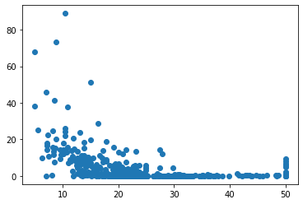
Scatter plot 1 comparing MEDV & RM variables

Slide 18
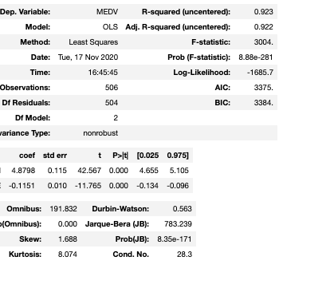
Regression analysis

